Slide 1
SOFTWARE ENGINEERING
SUPERVISOR MEETING
G1-T3
brought to you by Blab-bers
Bid Like A Boss..

Slide 2
Agenda
Project Management
Goals
Schedule
Test plan
Risk Assessment & Mitigation
Members skills Development Plans
Product
Wireframe / Added Functionality / Application Design / Prototype
Progress & Way ahead
Planned Vs Actual
Work Allocation
Programming Hours
Metrics
Problems Faced
Learning Points / Best Practices
Milestones for next 2 weeks

Slide 3
Team Goals

Slide 4
Goals
Maintain low stress levels
To be well-prepared and ensure smooth completion of each iteration
Maintain Professionalism
Be committed to deadlines for each task to prevent snowball
Create a project which we will be proud of
A+ for SE and Credit Suisse

Slide 5
Iterations & Milestones
Iteration 1
Iteration 2
Iteration 3
Iteration 4
Iteration 5
Wk-3 | Wk-5 | Wk-7 | Wk-9 | Wk-11 | Wk-14
Iteration | MileStones
#1 | Application Design(Use Cases, Diagrams, Wireframe)
#2 | Bootstrapping without JSON Validation CRUD Functionalities
#3 | Functionalities (Admin), User Interface, JSON
#4 | Round & Bidding Logic, Enhance User Interface, Integration
#5 | Internal UAT

Slide 6
Iteration #1
Wk-3 | Wk-4 | Wk-5
#1
Project Management
Application Design(Use Cases, Diagrams, Wireframe)

Slide 7
Iteration #2
Supervisor
Meeting
Wk-5 | Wk-6 | Wk-7
#2
Bootstrapping without JSON Validation
CRUD Functionalities

Slide 8
Iteration #3
Supervisor
Meeting
PM Review
Wk-7 | Wk-8 | Wk-9
#3
Functionalities (Admin)
User Interface
JSON Web Service

Slide 9
Iteration #4
Heuristic Evaluation
Wk-9 | Wk-10 | Wk-11
#4
Round & Bidding Logic
Enhance User Interface
Integration

Slide 10
Iteration #5
Supervisor Meeting
UAT Test
Wk-11 | Wk-12 | Wk1-3
#5
Internal UAT

Slide 11
Iteration #6
UAT Test
Final Presentation
 |  | Wk1-3 | Wk-14

Slide 12
Risk Assessment
All deadlines must be strictly adhered to!!!
S/N | Risk Statement | Risk Mitigation
1 | Team is unfamiliar with Netbeans Openshift, Bootstrap, SVN | Members who are familiar with the system will coach those who are unfamiliar All must be familiar by week 3.
2 | Team is unfamiliar with JSON, javascript, Jquery | 1. All are to research on required technologies. 2. Sharing by subject matter expert. 3. Hands-on practice on the technology. 4. Do forward planning with regard to UI to ensure that it will match up with the server side code.
3 | Mismatch between project outcome and requirements | 1. Plan first and lay out clearly the requirements. 2. Create a clear schedule metrics that adheres to the project requirements. 3. Project manager constantly ensure adherence to the requirements stipulated in the schedule metrics.

Slide 13
Product

Slide 14
Test Plan
Unit Test
Automated Test
Regression Test
Internal UAT
UAT

Slide 15
Skills Development Plan
Pair Programming
Code ownership and remedy
Mutual Feedback
Internal Coaching & Tests

Slide 16
Product

Slide 17
Progress & Way Ahead

Slide 18
Progress – Project Schedule
Planned Timeline
Start!
Bootstrapping
Functionalities
Finish Application Design
01/09
13/09
18/09
27/09
Actual Timeline
Start!
Bootstrapping
Functionalities
Finish Application Design
01/09
13/09
23/09
27/09
Deviation: JSON Reponse + Deployment & Testing (12 hours)
Notes:
We were faced with some technical difficulties, and as a result am behind schedule by 2 days. To circumvent this, we are shifting the schedule back, and we will put in slightly more hours in the next iteration. You can refer to the schedule we handed to you.

Slide 19
Work Allocation: Iteration 1
Task | Pang Zi Qi | Kong Yu Ning | Kevin Onggo | Nyein Su Aye | Nicholas
Schedule Planning | ü | ü
Test Cases/Test Plans |  |  | ü
Bug Metrics |  |  | ü
Risk Assessment Plan |  | ü
Use case Diagrams(Draft) |  |  | ü
Logical Diagram | ü |  |  | ü
Sequence Diagram | ü | ü |  |  | ü
User Interface (wireframe) |  |  |  | ü
Diagram Compilation + Update to SVN |  |  |  | ü
Quality Assurance | ü |  |  | ü
End of Iteration meeting + Application Design walkthrough | ü | ü | ü | ü | ü

Slide 20
Work Allocation: Iteration 2
Task | Pang Zi Qi | Kong Yu Ning | Kevin Onggo | Nyein Su Aye | Nicholas
BootStrapping (Upload, Read, Validate, Insert) | ü | ü | ü | ü | ü
Bid for Session |  |  | ü | ü
Drop Bid |  |  | ü | ü
Drop Session |  |  | ü |  | ü
Update Bid |  |  | ü |  | ü
Login |  |  |  | ü
Search Course |  |  | ü |  | ü
View All Bids |  | ü |  | ü
Deployment & Testing | ü | ü | ü | ü | ü

Slide 21
Programming Hours (Iteration #2)
Due: Presentations & SMUX elections
Due: Project Manager
***Hours will be balanced in iteration 3.

Slide 22
Stipulated Programming Hours (Iteration #3)
25hrs
35hrs
25hrs
20hrs
40hrs

Slide 23
Metrics
Iteration 1
 | Schedule | Bug | Pair Programming
Score | 1.0 | - | -
Action | - | - | -
Iteration 2
 | Schedule | Bug | Pair Programming
Score | 1.0 | 12 | 3.27
Action | None | Fixed Upon discovery | Slightly altered Schedule

Slide 24
Problems Faced
Overestimated /Underestimation of task complexity / duration
Schedule was too functionality oriented. Split into too many tasks.
Conflicts in subversion commits
Bottlenecks arose due to code dependency
Uneven job distribution. (Did not prepare PPLog before hand)

Slide 25
Best Practices – Learning Points
Code first, refactor later
Be disciplined in coding and naming conventions
Knowledge management system (Code Issues Tracker)
Refurbish Schedule (See new schedule)

Slide 26
Milestones for next 2 Weeks
Supervisor Meeting
Functionalities for Admin + UI
PM Review
01/10
09/10
11/10
Week-7
Week-8

Slide 27
Important dates to note
Personnel | Conflicts | Date
Kong Yu Ning | Final presentation (Due: TSM Beijing) | Nov 16th – 23rd
Nicholas Lee | Credit Suisse (Due: OCSP) | Dec 8th – 25th

Slide 28
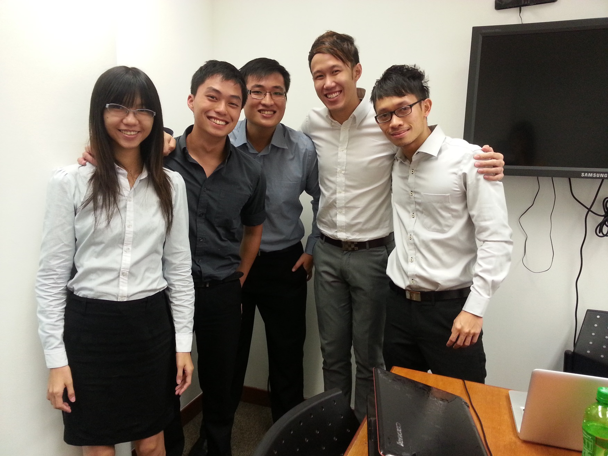
The End

